Slide 1
Organizing college Studies
By: Amer Taleb Al Ajouz
Sameeh Moghrabi
Carl Habib
COE 418: Database Systems

Slide 2
What Do we cover
The details of Instructors
The registration process
Each student and their info
The permissions of each and every user

Slide 3
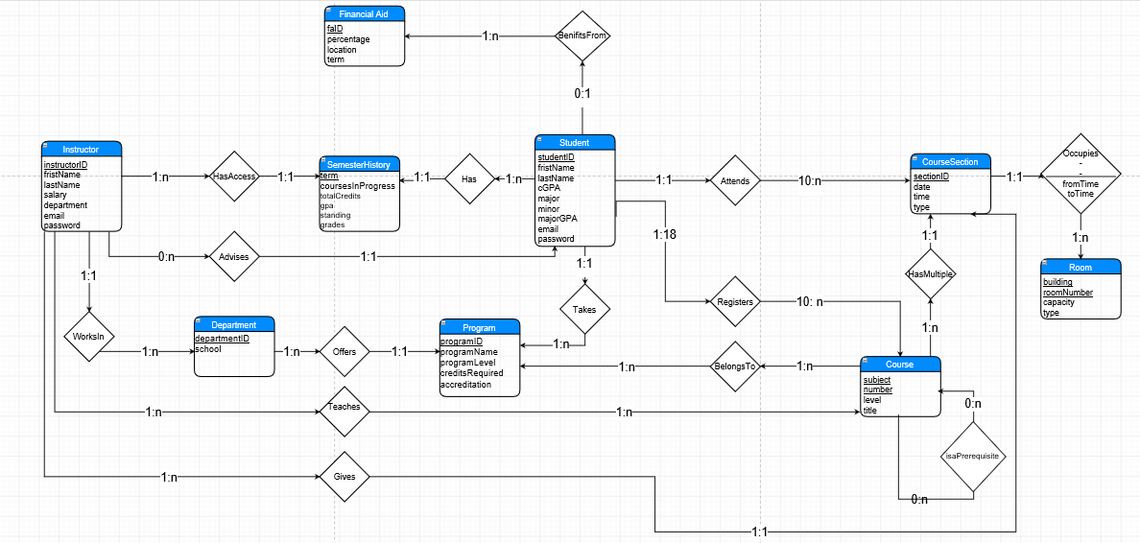
CDM

Slide 4
What Next
Creation of the LDM and the Actual DB

Slide 5
Thank You

